Slide 1
Initial Project Presentation
Chad Madding
Shane Weinstock
YouTube Link
https://youtu.be/PfubByd1nMc

Slide 2


Our Team
Shane Weinstock
Chad Madding

Slide 3
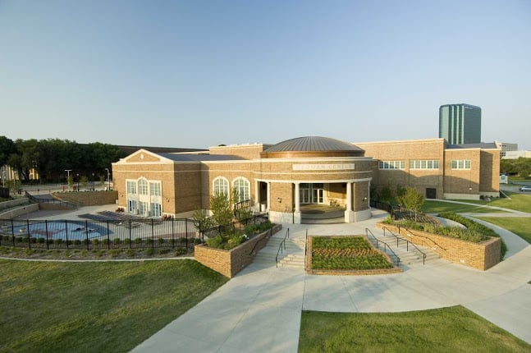
Data Set
What: The data is from a turnstile at the Dedman Center for Lifetime Sports on the Southern Methodist University campus.
The data was provided to us by the University
It measures the activity of Dedman by ID card swipes through turnstiles.
The data utilized are entries from Jan 2019 through March, 11 2020 (present day).
We would like to predict future usage of the facility and attempt to assess demand and staffing needs.
Through the data collected, we will assess correlated values and seasonal aspects of the facilities usage.

Slide 4
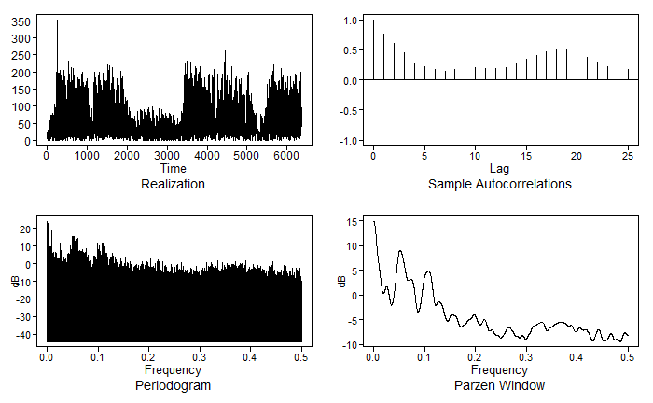
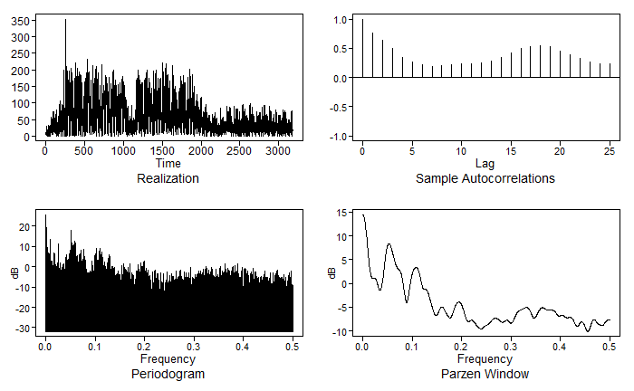
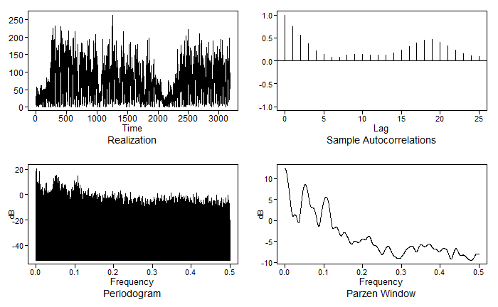
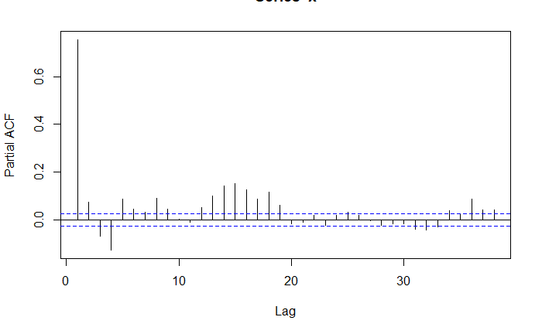
Stationary / Non-Stationary
Entire Data
First Half
Second Half
In the above plots we can observe the following conditions:
The mean does not depend on time
The variance does not depend on time
The ACF also does not depend on time
From these plots we can assume that all conditions have been met for a stationarity.

Slide 5
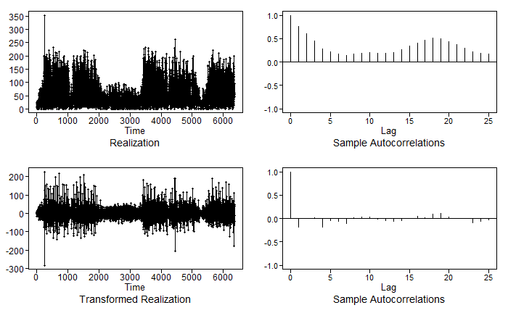
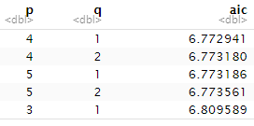

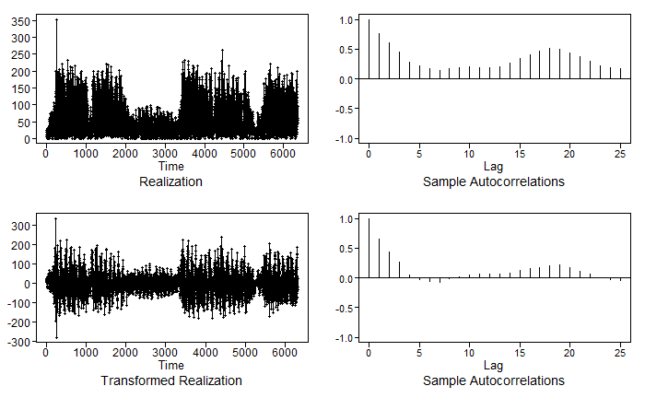
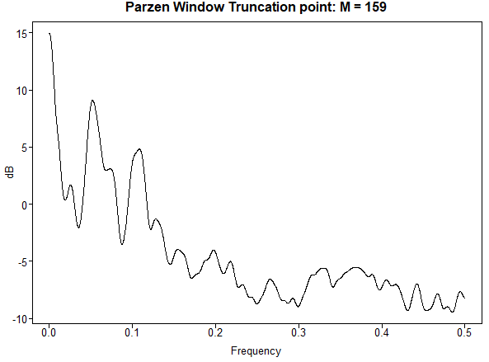
Fitting the Model
After exploring the data and our factor tables, we removed a factor of (1-B) in our first model and discovered for our second model that the spectral density pattern was similar to a seasonality of (1-B^36). This looks to tie in with a 9 month weekly pattern (9*4=36) associated with less people on campus during the Summer months.
(1-B) Transformation
We then proceeded to running the AIC5 to obtain a model. Crosschecking it with the BIC.
(1-B^36) Transformation

Slide 6
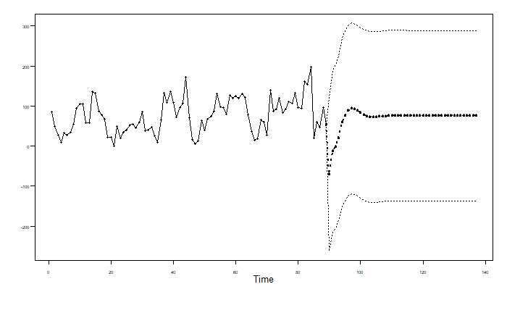
Model 1
ARIMA(4,1,1)
The model above is depicted in the graph to the left.
The graph left shows predictions 48 hours into the future based off the model above.
ASE = 2517.86642510008

Slide 7
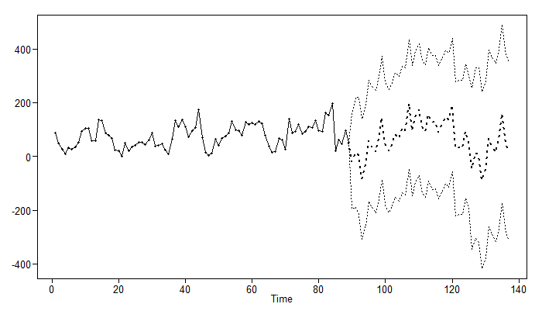
Model 2
ARMA(15,5) with s = 36
The model above is depicted in the graph to the left.
The graph left shows predictions 48 hours into the future based off the model above.
ASE = 3370.41727867694

Slide 8
Analyzing our two Models
The models we’ve initially produced for this analysis were very different.
The ASE for model 1 was considerably lower, and of course the model was much simpler.
Model 2 shows a very extensive forecast and a continued trend.
Due to the nature of the first model’s characteristics, we would believe it is more accurate. However, without further instruction on these models it’s difficult to tell how much inference we can truly draw from the second model.

Slide 9
Strategies for the Future
There is definitely seasonal patterns in the data which we have attempted to accommodate through our domain knowledge of the Dedman Athletic Center.
We plan to integrate weather data into this analysis to better predict future usage.
We may be able to better assess seasonality with variables contained within our data as well, and address this accordingly to develop better forecasts.
The ultimate goal is to be able to predict facility usage and continue to estimate the student staffing needs.

